Slide 1
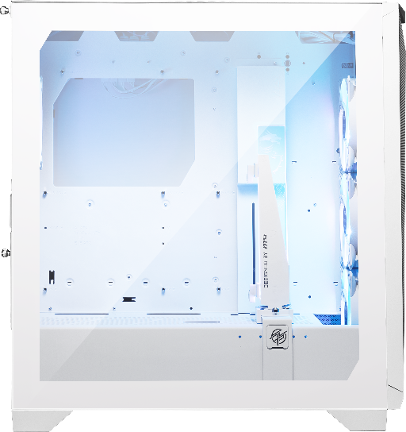
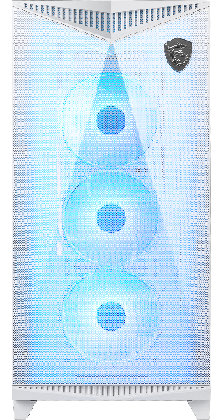
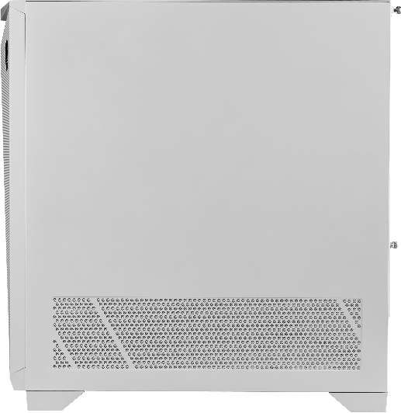
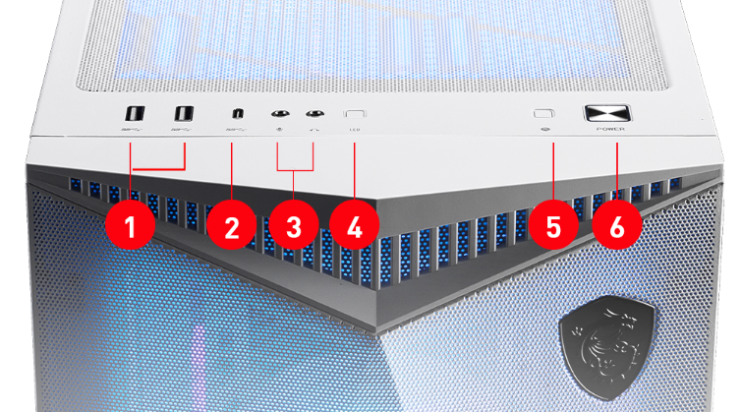
PC CASE
SPECIFICATIONS
FEATURES
Product Name |  | MPG GUNGNIR 300R AIRFLOW WHITE
Form Factor |  | Mid-Tower
Motherboard Form Factor Support |  | E-ATX(up to 280 x 305 mm) ATX / M-ATX / ITX
I/O Ports |  | 2x USB 3.2 Gen 1 Type-A 1x USB 3.2 Gen 2x2 Type-C 1x Audio-Out 1x Mic-In 1x Reset Button 1x LED Switch Button
Drive Mount Supports |  | 6x 2.5” 2x 2.5”/3.5”
Expansions Slots |  | 7
Maximum GPU |  | Length GPU holder at right front:360mm / 14.17 inches GPU holder at right rear:340mm / 13.39 inches Height Horizontal installed: Max. up to 142mm / 5.59 inches Vertical installed: Max. up to 150mm / 5.91 inches Thickness Max. up to 80mm / 3.15 inches
Maximum CPU Cooler Height |  | 175mm / 6.9 inches
Power Supply Support |  | ATX
Maximum PSU Length |  | Above 220mm
 |  | Top: 3x 120 mm / 2x 140 mm Front: 3x 120 mm / 3x 140 mm Rear: 1x 120 mm / 1x 140 mm Side: NA PSU Shroud: 2x 120 mm Vertical GPU bracket: 2 x 60mm (thickness: 15mm) Cable Cover: 1 x 80mm / 1 x 120mm
Fan Size Support
Pre-Installed Fan Size |  | Front: 3x 120 mm Rear: 1x 120 mm
Pre-Installed Fan Type |  | Front: 3x PWM ARGB Fan Rear: 1x PWM ARGB Fan
Radiator Size Support |  | Top: 120 / 140 / 240 / 280 / 360 mm Front: 120 / 140 / 240 / 280 / 360 mm Rear: 120 / 140 mm Side: NA Bottom: NA
Dimensions (D x W x H) |  | 505 x 235 x 510 mm / 19.88 x 9.25 x 20.08 inches
Net Weight |  | 11.1 kg / 24.47 lbs
Gross Weight |  | 13.4 kg / 29.54 lbs
 | Amazing Air Flow Possibility
 | Up to 10 fans of various sizes can be installed. A 80mm gap at the top and front are reserved for Push-Pull installation, and supports dual 360mm radiators at the top and front.
 | RTX 40 Series Graphics Card Support
 | No matter the longer, thicker or heavier of the graphics card, It is fully supported vertical or horizontal installation, also reserved enough space to ensure cooling and cable bending.
 | Omnidirectional Graphics Card Stand
 | The graphics card stand can be adjusted in many ways to support different graphics card installation.
 | Switchable PCI-E Brackets
 | Vertical GPU bracket supports installation of graphics card vertically without installing extra bracket and also can install 2 x 60 mm fans in the same time.
 | Multiple-Function Cable Cover
 | The cable cover can be moved to support E-ATX motherboards and can be installed additional fan by attached fan bracket to enhance airflow.
 | User Friendly
 | The patent pending sliding HDD cache and GPU holder. MSI chassis also uses the push latches construction on the PCI-E bracket, side panel ,and multiple function cable cover.
 | 1 to 6 ARGB-PWM Control Board
 | This fan control board supports up to 6 x PWM fans with ARGB function. Allow you to use the LED switch button to adjust the ARGB lighting intuitionally.
CONNECTIONS
2x USB 3.2 Gen 1 Type-A
1x USB 3.2 Gen 2x2 Type-C
Mic In/ Audio Out
LED Switch Button
Reset Button
Power Button
© 2023 Micro-Star Int'l Co.Ltd. MSI is a registered trademark of Micro-Star Int'l Co.Ltd. All rights reserved.

Slide 2
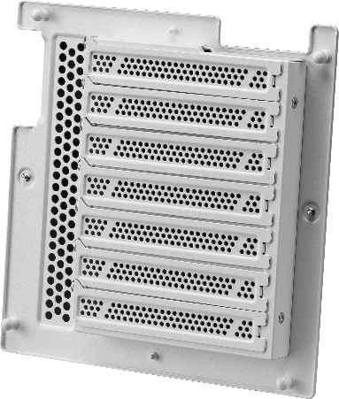
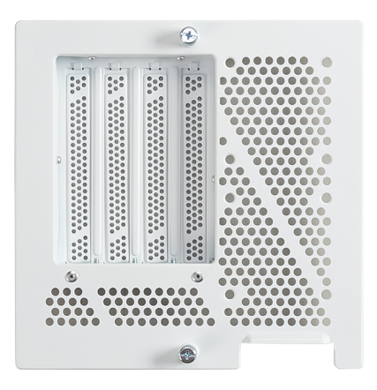
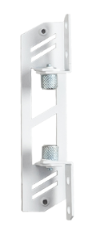
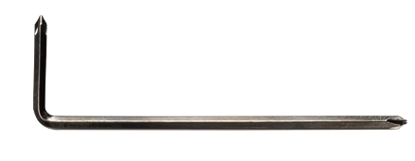
PC Case Accessory
 | Horizontal PCIe Bracket(pre-install) | X 1
 | Vertical PCIe Bracket | X 1
 | Cable Cover Fan Bracket | X 1
 | Graphics Card Install Tool | X 1

