Slide 1




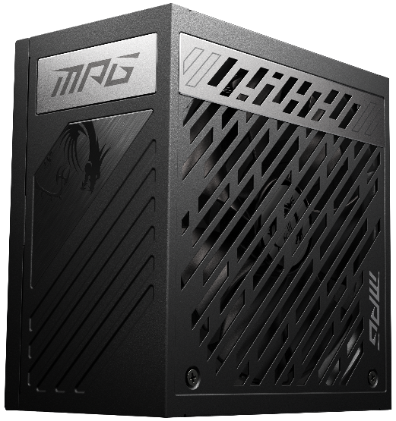
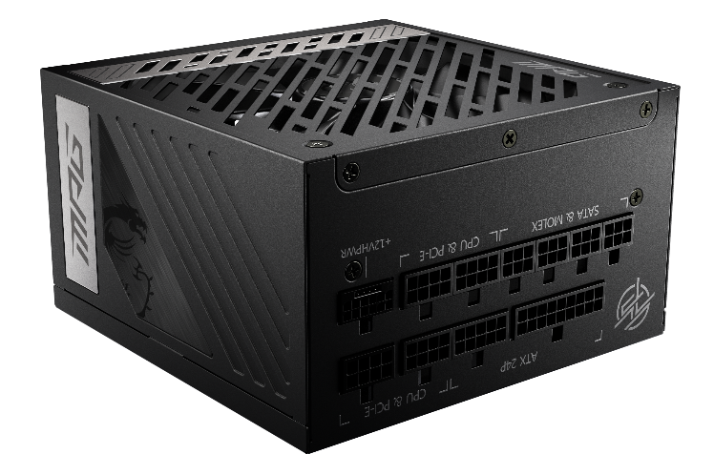


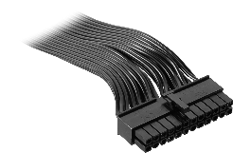
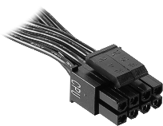
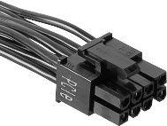
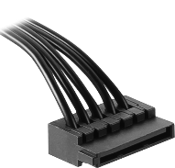
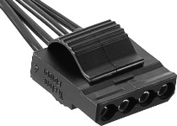
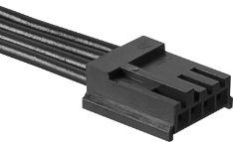
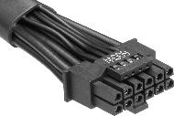
SPECIFICATIONS
80 PLUS Gold Certification
PCIe 5.0 and ATX 3.0 Compatible
100% Japanese Electrolytic capacitor
Full Modular design
Active PFC design
Industrial level protection with OCP,OVP,OPP,OTP, SCP,UVP
DC-DC Module Design
Flat Cables
Single Rail Design
Fan 0 RPM Mode
Product Name |  | MPG A1000G PCIE5
Form Factor |  | ATX
Power Wattage |  | 1000W
Efficiency Rating |  | 80 PLUS Gold (up to 90%)
Modular |  | YES (Fully-Modular)
Fan Size |  | 135 mm
Fan Bearing |  | Fluid Dynamic Bearing
Dimensions (D x W x H) |  | 150 x 150 x 86mm / 5.9 x 5.9 x 3.4 inches
PFC Type |  | Active PFC
Input Voltage Range |  | 100-240~
Input Frequency Range |  | 50~60Hz
Protection |  | OCP,OVP,OPP,OTP, SCP,UVP
MPG A1000G PCIE5
AC INPUT | 100-240~, 13A, 50-60Hz,(200-240~,6.5A,50-60Hz仅适用中国)
DC output | +5V | +3.3V | +12V | -12V | +5Vsb
 | 22.0A | 22.0A | 83.5A | 0.3A | 3.0A
 | 120W |  | 1000W | 3.6W | 15W
Total power | 1000W
CONNECTOR
ATX (24 PIN) | EPS (4+4 PIN) | PCIe (6+2 PIN) | PCIe (16 PIN) | SATA | MOLEX (PERIPHERAL) | FDD
1 | 2 | 6 | 1 | 12 | 4 | 1
© 2022 Micro-Star Int'l Co.Ltd. MSI is a registered trademark of Micro-Star Int'l Co.Ltd. All rights reserved

Slide 2
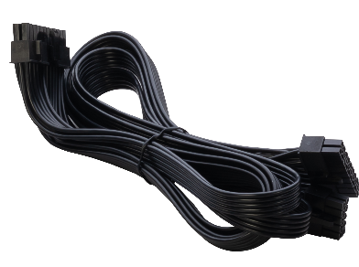
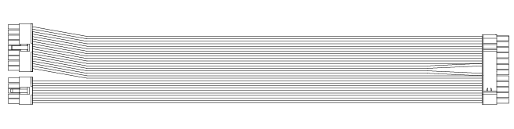
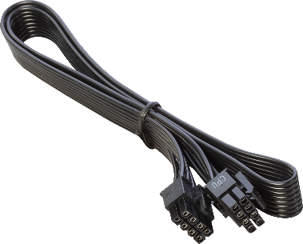
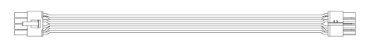
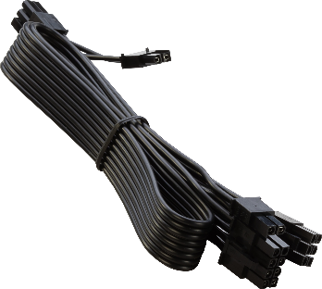
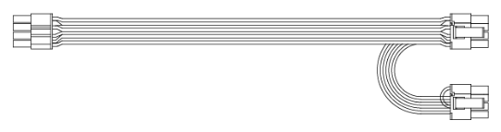
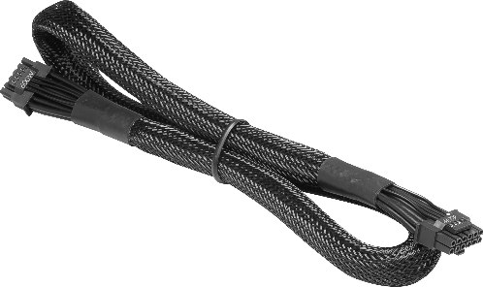
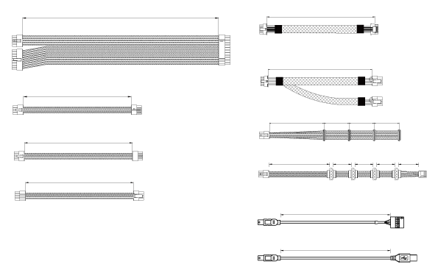
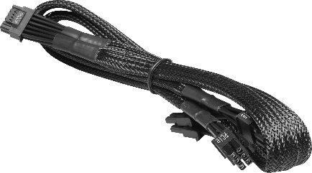
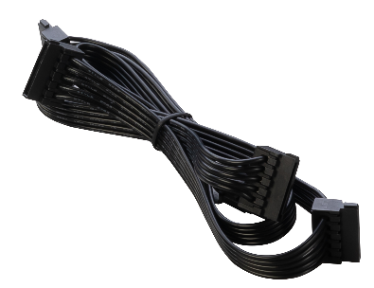
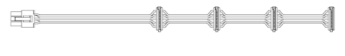
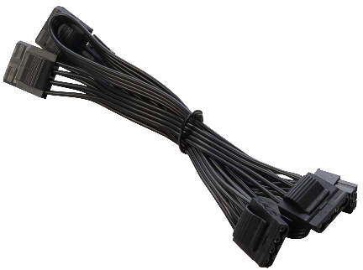
Power Supply Cable
 |  | ATX Cable x1
 |  | EPS (8 PIN to 4+4 PIN) Cable x2
 |  | PCIe (8 PIN to 6+2 PIN) Cable x2
 |  | PCIe (16 PIN to 16 PIN) Cable x1
 |  | PCIe (16 PIN to 6+2 PIN) Cable x1
 |  | SATA Sleeved Cable x3
 |  | MOLEX/FDD Sleeved Cable x1
600mm
700mm
600mm
600mm
600mm
500mm
3 x 150mm
500mm
4 x 150mm
© 2022 Micro-Star Int'l Co.Ltd. MSI is a registered trademark of Micro-Star Int'l Co.Ltd. All rights reserved

