Slide 1

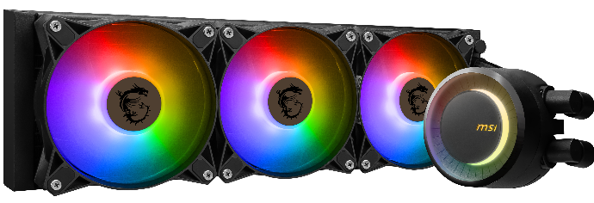
LIQUID COOLING
Selling Point:
The enlarged copper base surface area helps to achieve ultimate heat exchange with the latest CPU generation.
Maximize micro-channels to dissipate heat efficiently
Rotatable water block cap for 270 degree.
ARGB fan can change the lighting by MSI center.
Enhanced fan performance to dissipate heat quickly.
Pump is separating the rooms of cool water and hot water to avoid mixing water temperatures and effectively reduce the heat source.
Durable three phase motor of the pump generates minimal vibrations for long-lasting operation.
Spilt pathway through the radiator rapidly dissipates heat.
SPECIFICATIONS
Radiator Fan info
Number of Fans |  | 3
Fan Dimensions |  | 120 x 120 x 25mm / 4.7 x 4.7 x 0.98 inches
Fan Speed |  | 600±250RPM-1800±200RPM
Fan Air Flow |  | 25.5~75.04 CFM
Fan Noise Level |  | 11.2~32.5 dBA
Fan Static Pressure |  | 0.31~2.52 mm-H2O
Fan Bearing |  | Fluid Dynamic Bearing (FDB)
Fan Life Expectancy |  | 50,000 hrs@40℃
Fan Rated Current |  | 0.25A(Max:0.4A)
Fan Power Consumption |  | 3W(Max:4.8W)
PWM Mode |  | Yes
Cable Length (5V ARGB / PWM cable) |  | 550 / 500 mm; 21.65 / 19.69 inches
Fan Lighting |  | ARGB
ARGB Connector |  | Pin + Socket
CPU Block Info
Cold Plate Material |  | Copper
Block Dimensions |  | 41±0.2*47.6±0.2mm
Intel Socket |  | LGA 1150/1151/1155/1156/1200/1700
AMD Socket |  | AM5/AM4/TR4
Panel Size |  | -
Panel Type |  | -
Panel Resolution |  | -
Panel Color bit |  | -
Panel Brightness |  | -
Pump Info
Pump Life Expectancy |  | 200,000 hours in typical use
Pump Noise Level |  | 20 dBA (avg.)
Pump Load Current |  | 0.5A
Pump Power Consumption |  | 6W
Pump Speed |  | 3000 RPM ± 10%
Pump Connector |  | 4 Pin
Radiator Info
Radiator Size |  | 360 mm
Radiator Dimensions |  | 394 x 119.2 x 27mm / 15.51 x 4.69 x 1.06 inches
Radiator Material |  | Aluminum
Water Cooling Tube Material |  | Black Rubber
Water Cooling Tube Length |  | 400mm / 15.75 inches
Accessories
 |  | 1 to 3 Fan PWM cable x 1 Molex 4-Pin to 4-Pin fan cable x 1 Noise reducer cable x 1 Thermal paste x 1
© 2023 Micro-Star Int'l Co.Ltd. MSI is a registered trademark of Micro-Star Int'l Co.Ltd. All rights reserved..

